Slide 1



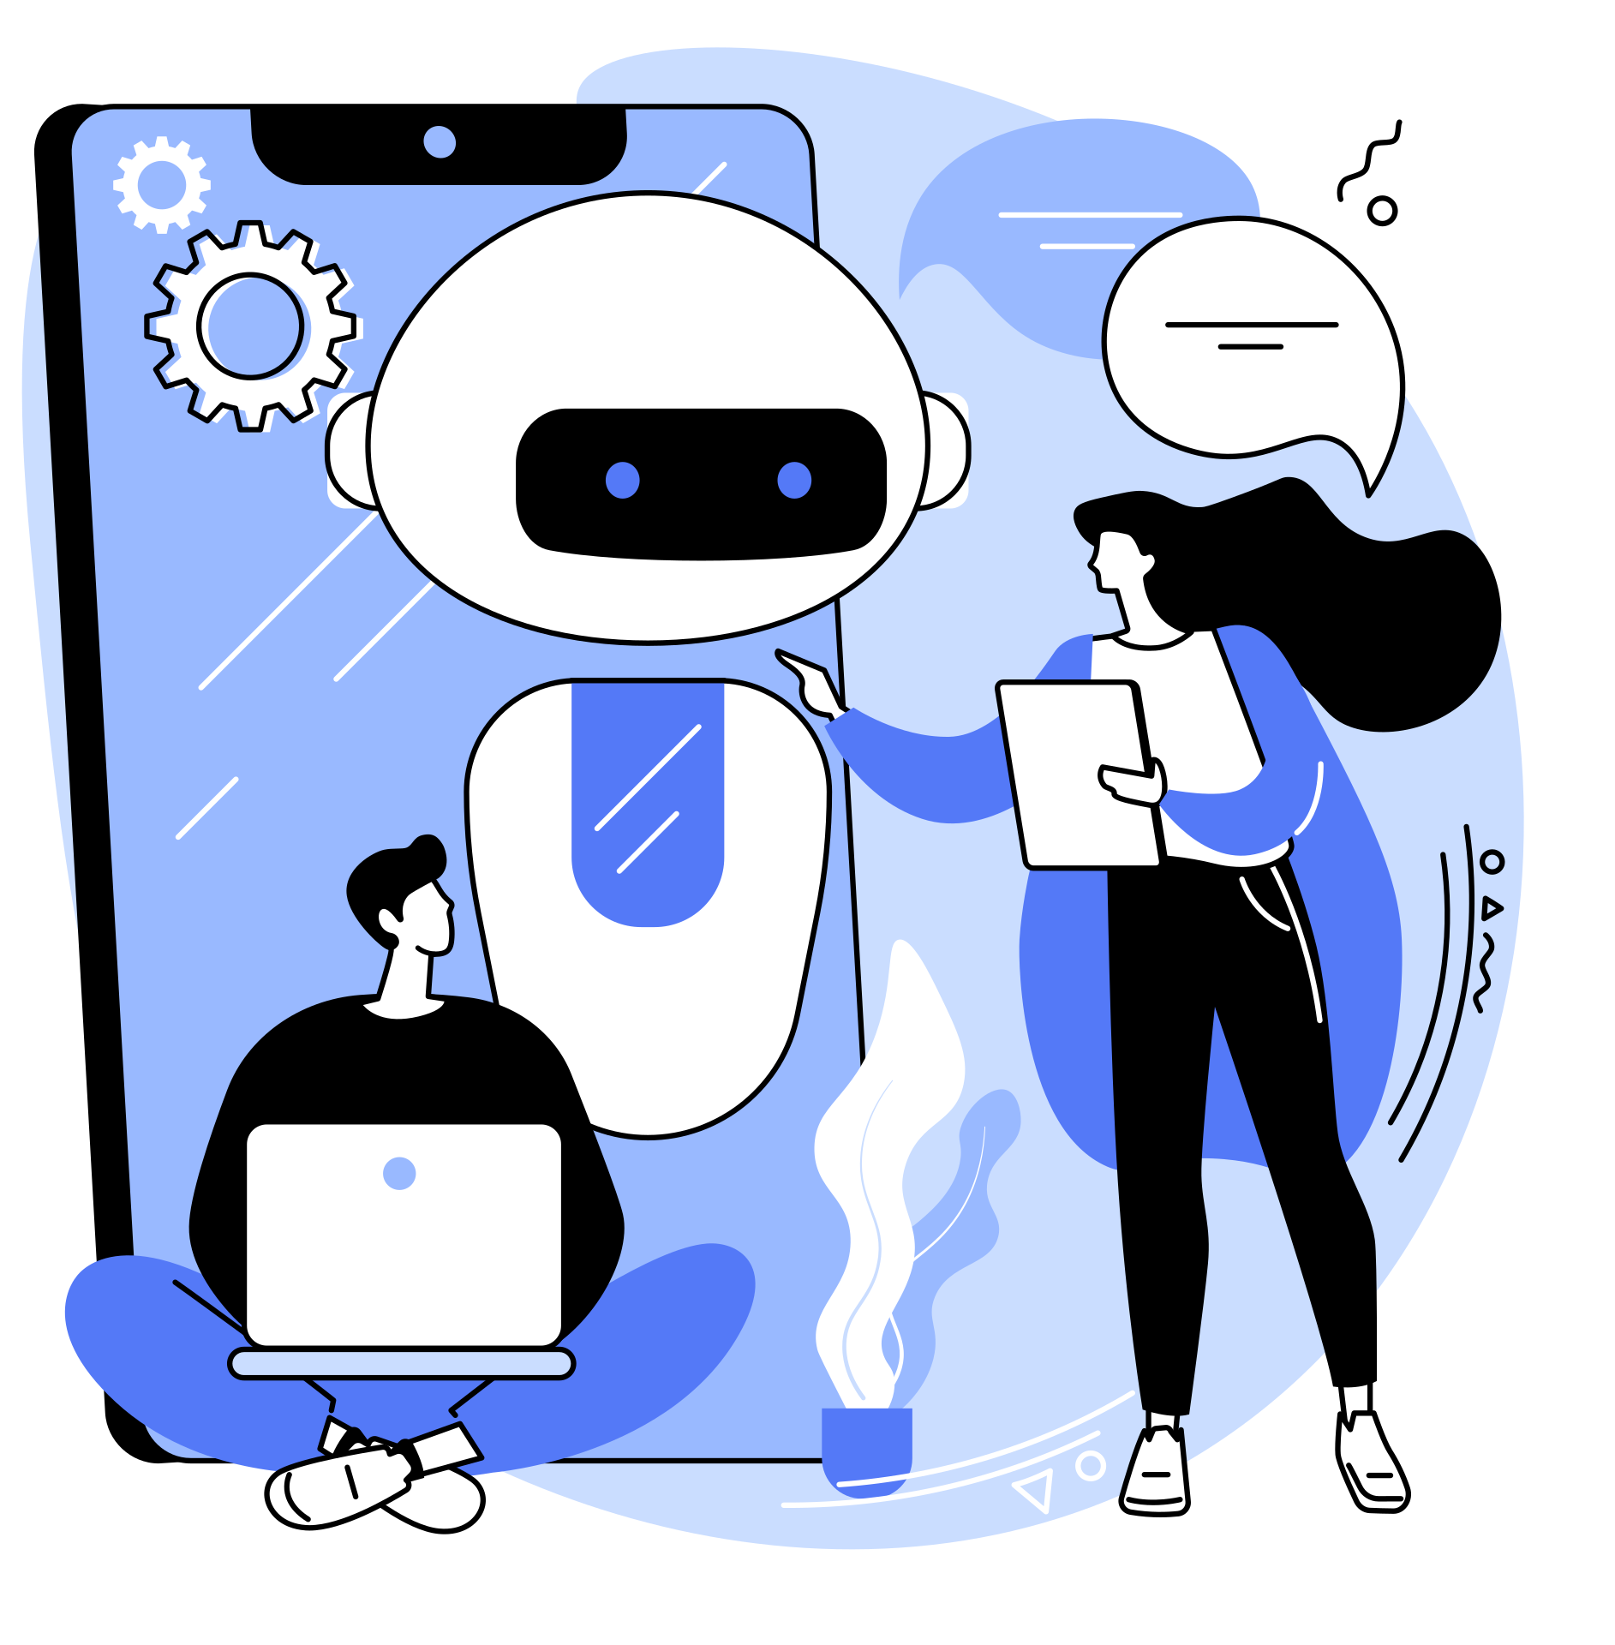

vicol olawade
Death by AI:
Will large language models diminish Wikipedia?
A presentation by:
Vicol Olawade

Slide 2


vicol olawade
Table of Contents
1
Introduction
03
5
The Role of AI Writer Bots
07
2
Research Model & Hypothesis
04
6
Data & Findings
08
3
The Wikipedia Feedback Model
05
7
Discussion & Implications
09
4
Key Components of the Research Model
06
8
Conclusion
10

Slide 3
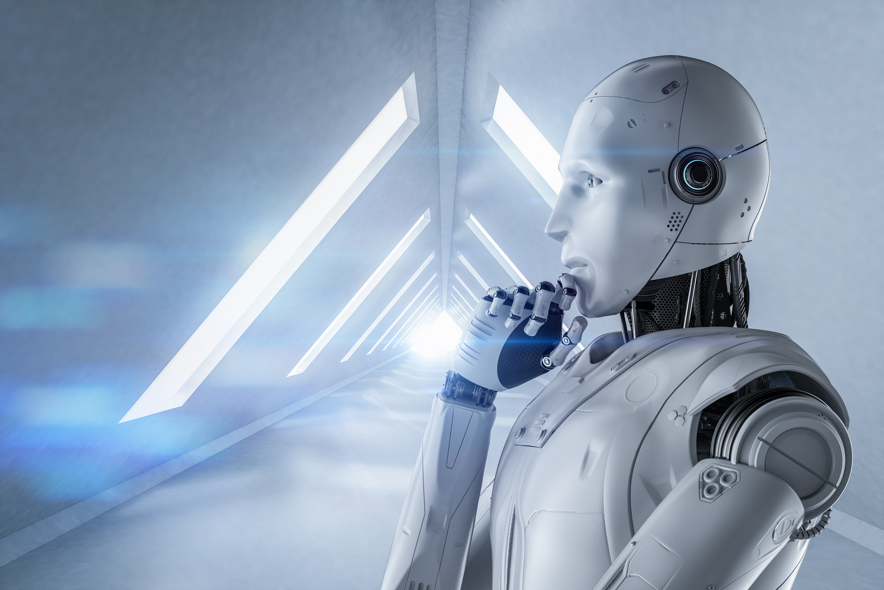

vicol olawade
Introduction
We explore the potential impact of Large Language Models (LLMs) and generative AI on Wikipedia, a user-driven knowledge platform. This research argues that as AI systems improve at generating content and answering questions, human contributors may withdraw, leading to a decline in Wikipedia’s value. The study presents a feedback model illustrating how AI’s growing role as both a reader and a writer could disrupt Wikipedia’s traditional cycle of human contributions and readership, ultimately leading to stagnation or decline in Wikipedia's usage
The Problem Statement
Declining Human Contributions: AI’s ability to generate content may discourage human editors from contributing, reducing Wikipedia’s quality and reliability.
Reader Disintermediation: Users may turn to AI-driven platforms instead of Wikipedia for answers, leading to fewer visits and lower engagement.
Misinformation Risk: AI-generated content may introduce false or misleading information, undermining Wikipedia’s credibility

Slide 4

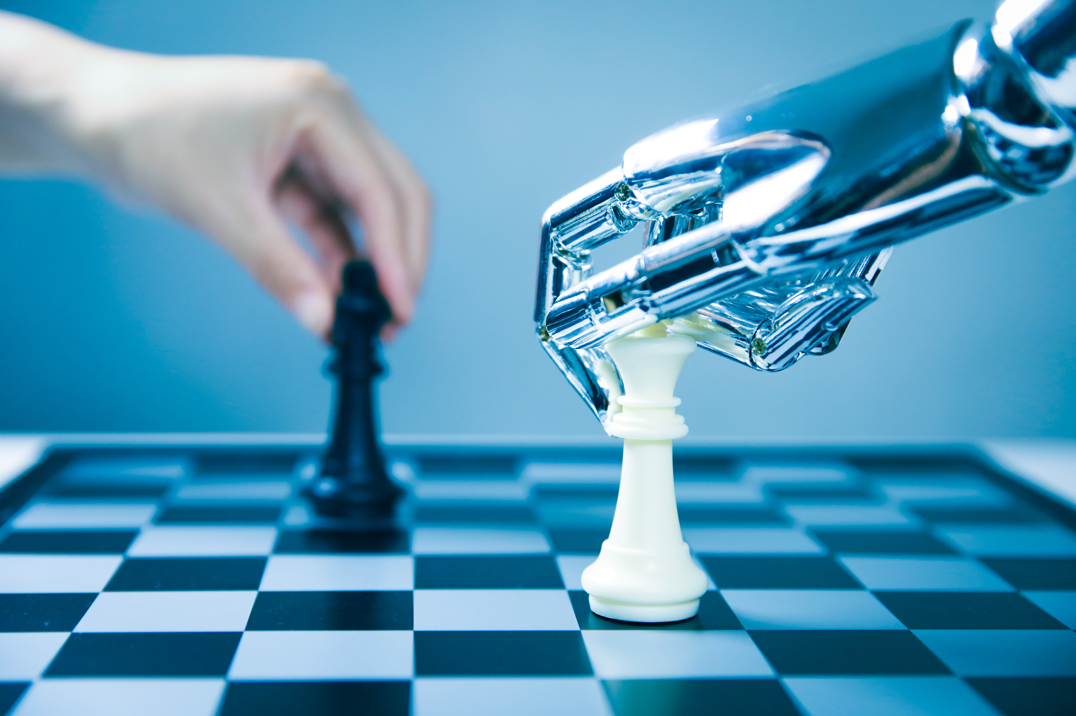


vicol olawade
Research Model & Hypothesis
The research presents a feedback model showing how Wikipedia’s traditional cycle—where readers become contributors—is being disrupted by AI. Large language models (LLMs) act as both answer bots (replacing human readers) and writer bots (competing with human contributors). This shift may lead to fewer human contributions, outdated content, and Wikipedia’s diminishing value over time.
Research Models
Wikipedia’s Feedback Cycle
The Hypothesized Impact of AI
Wikipedia traditionally functions through a positive feedback loop: Contributors create content → Readers consume it → Some readers become contributors.
The research hypothesizes that increased AI involvement will lead to reduced motivation for human contributors, creating a negative cycle that diminishes Wikipedia’s long-term value.

Slide 5
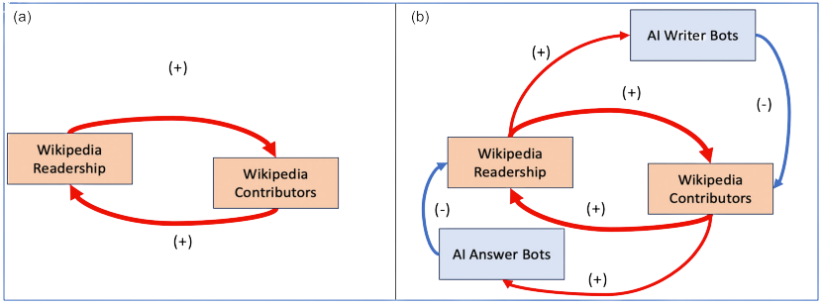
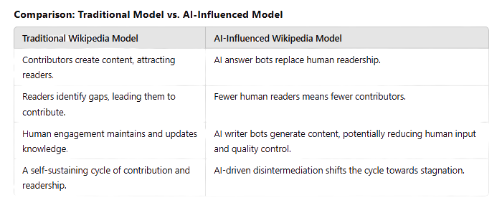
vicol olawade
The Wikipedia Feedback Model
The Wikipedia Feedback Model illustrates the relationship between contributors and readers in maintaining the platform’s growth. Traditionally, human contributors create and edit content, attracting readers who may later become contributors, sustaining a positive cycle of knowledge production. However, the introduction of AI disrupts this balance by automating both content consumption and creation, reducing the need for human involvement.

Slide 6


vicol olawade
Key Components of the Research Model
The research model explores how Wikipedia’s contributor-reader relationship operates as a feedback system. Unlike a traditional cause-and-effect model, this feedback model highlights how human engagement and AI-driven automation can reinforce or disrupt Wikipedia’s sustainability. The model predicts that AI answer and writer bots will gradually weaken human contributions, leading to a decline in Wikipedia’s asset value.
Contribution and Asset Value
Readership and Disintermediation
Wikipedia’s knowledge base depends on voluntary human contributors.
As AI-generated content increases, contributors may lose motivation, leading to stagnation.
Wikipedia’s long-term value is tied to the quality and quantity of human contributions.
AI-powered search tools provide direct answers, reducing Wikipedia’s traffic.
Fewer readers mean fewer potential contributors, weakening the feedback cycle.
Over time, AI’s dominance may diminish Wikipedia’s relevance as a knowledge source.

Slide 7

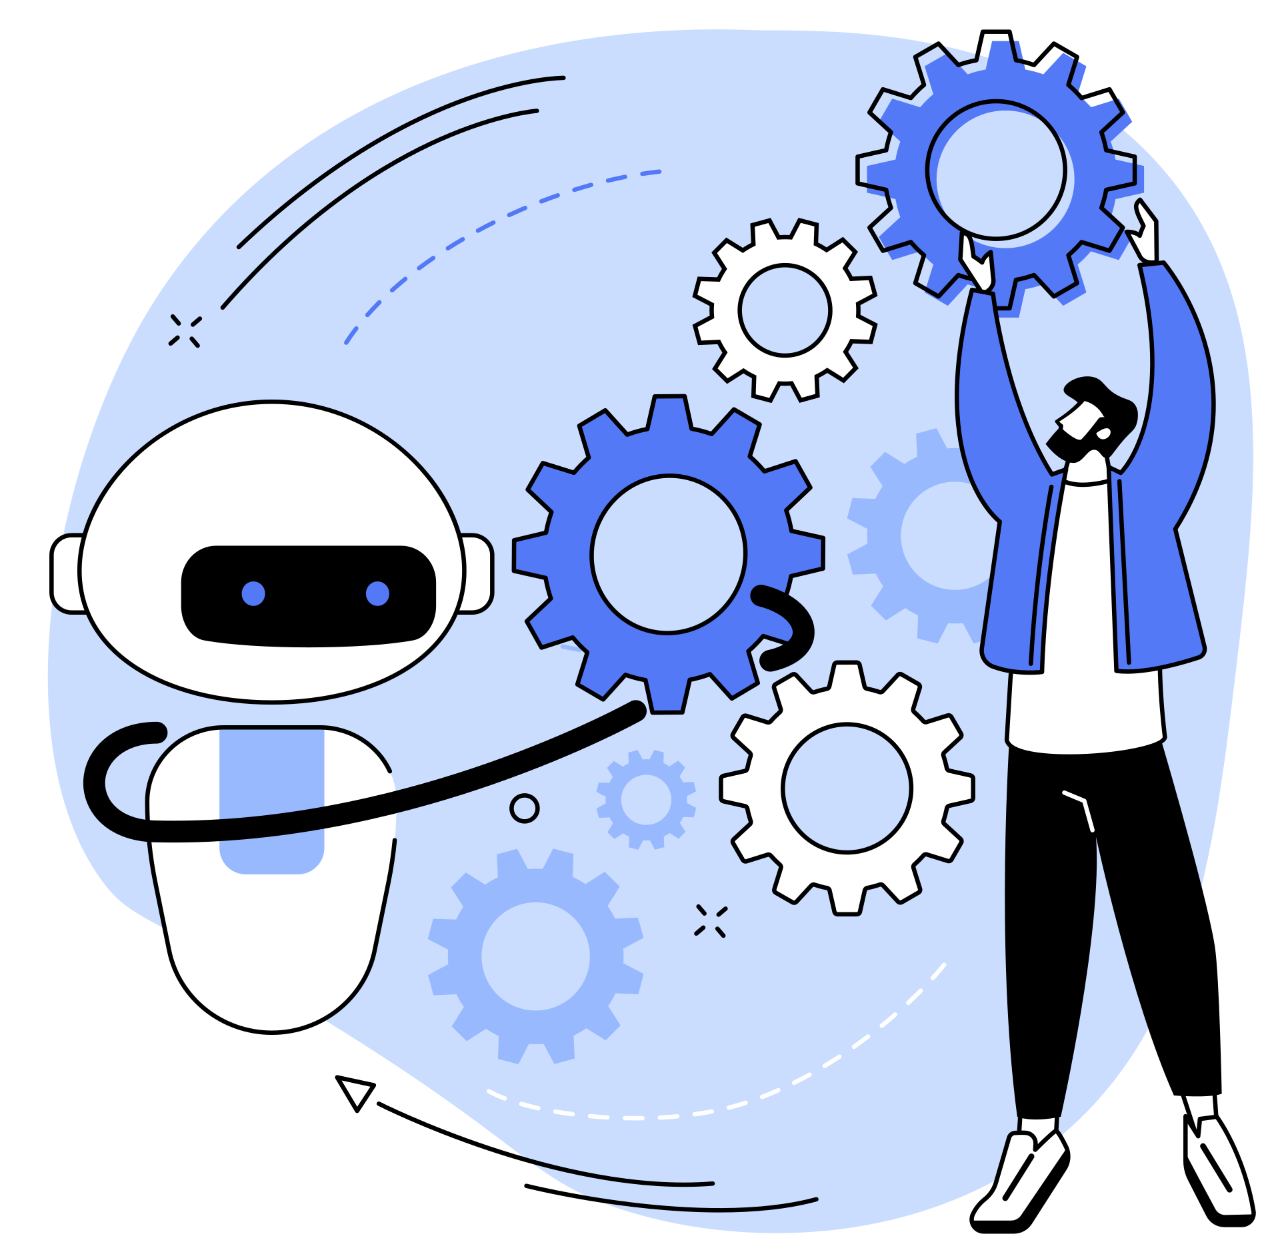
vicol olawade
The Role of AI Writer Bots
AI writer bots were introduced to assist human contributors by automating routine edits and content updates. However, these bots now pose challenges by competing with human editors, reducing engagement, and introducing potential misinformation. The research highlights the unintended consequences of AI’s increasing role in Wikipedia’s content creation.
AI as a Contributor
Challenges and Risks
AI bots assist in maintaining and updating Wikipedia’s vast database.
They help automate repetitive tasks and manage large volumes of content efficiently.
AI-generated content can introduce factual errors or misleading information.
Deletionist AI bots may remove legitimate content, frustrating human editors.

Slide 8
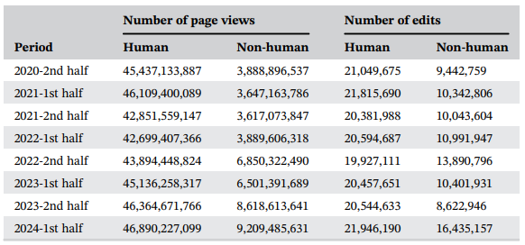
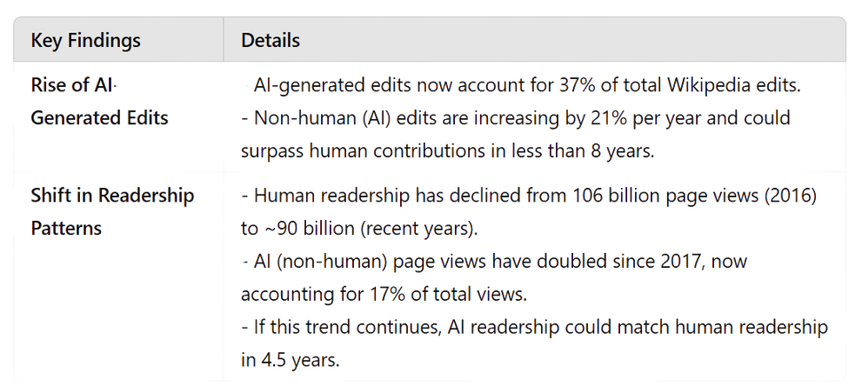
vicol olawade
Data & Findings
The research presents data on the evolving role of AI in Wikipedia, highlighting trends in human vs. AI contributions. It shows that while human contributor numbers remain stable, AI-generated edits and AI-driven readership are increasing rapidly, raising concerns about Wikipedia’s long-term sustainability.

Slide 9
vicol olawade
Discussion & Implications
The increasing role of AI in Wikipedia is shifting the platform’s balance from a human-driven knowledge base to an AI-dominated ecosystem. The study suggests that this shift could weaken human engagement, reduce Wikipedia’s credibility, and reshape the future of open knowledge sharing.
The Shift from a Virtuous to a Vicious Cycle
Wikipedia’s Declining Visibility
Potential Risks to Knowledge Quality
Traditionally, Wikipedia thrived on human contributors maintaining and improving content.
AI-generated answers reduce readership, which in turn reduces the number of new contributors.
This negative feedback loop may lead to outdated or lower-quality content over time.
AI-powered assistants extract Wikipedia content but do not direct users back to the platform.
As AI readership grows, Wikipedia’s direct engagement decreases, reducing incentives for human contributors.
AI-generated content can reinforce biases, introduce misinformation, and reduce content originality.
Over-reliance on AI could lead to "knowledge deterioration," where AI reuses its own data instead of human-reviewed sources.

Slide 10
vicol olawade
Conclusion
While AI tools offer efficiency, they also risk reducing human contributions, which are essential for maintaining knowledge accuracy and diversity. The future of Wikipedia depends on balancing AI’s role while preserving human engagement.
Wikipedia Faces an Existential Challenge
Need for AI-Human Collaboration
Possible Solutions for Sustainability
AI is becoming both a consumer and creator of Wikipedia content.
If human contributors withdraw, Wikipedia may lose its credibility and relevance.
Wikipedia must integrate AI responsibly while ensuring human oversight.
Hybrid models, where AI assists but does not replace human contributors, could sustain quality.
Introduce incentives for human contributors (e.g., recognition, rewards).
Strengthen AI governance to prevent misinformation and maintain Wikipedia’s integrity.
Encourage community engagement through initiatives like the Wikipedia Education Program.

Slide 11
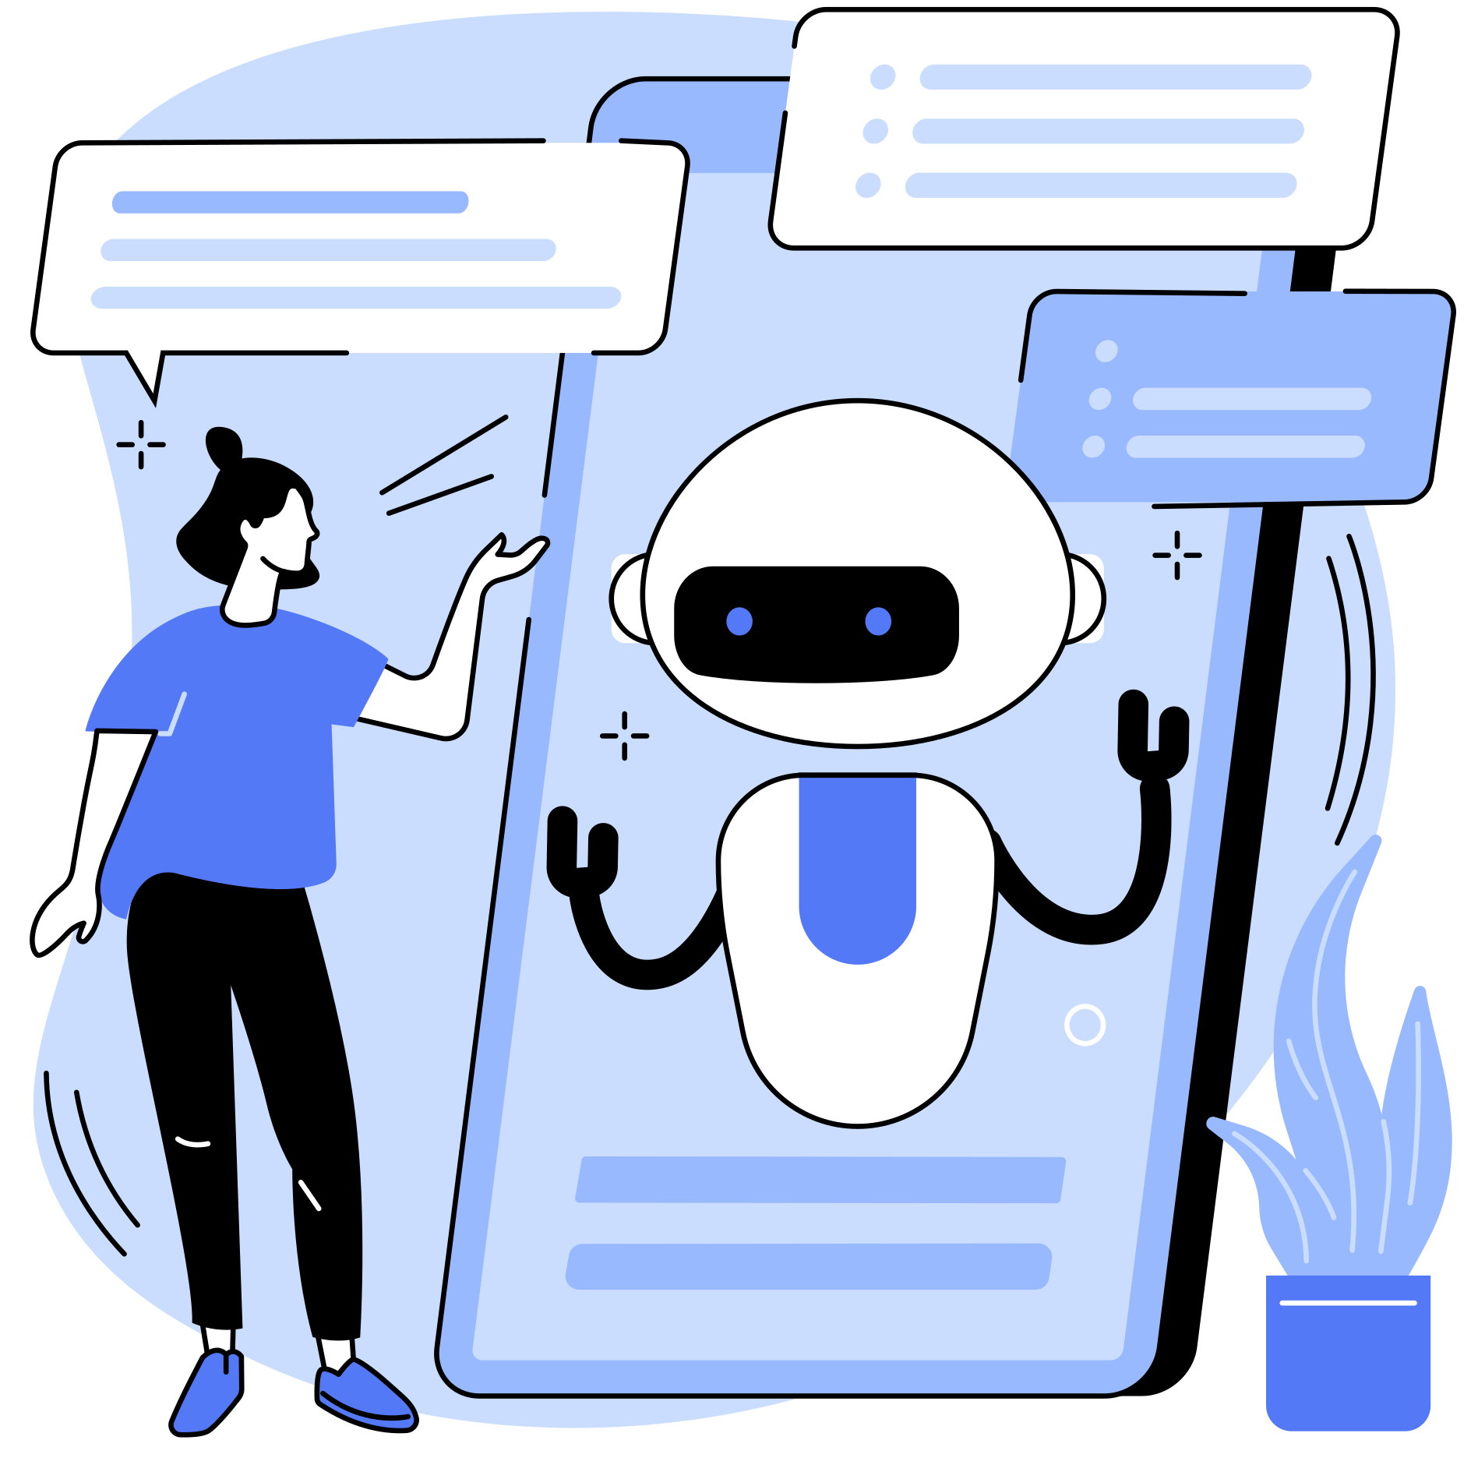
vicol olawade
Thank You for listening

